Slide 1
Classification of Pubmed ‘taste’ abstracts and expression profiling
Final report, Lars v. Buchholtz, 03/ 16/2017

Slide 2
Inspiration for this project
data vs information
information content depends on specific question and techniques available to extract information from data
daily Pubmed search with term ‘taste’:
hardly any relevant publications missed
>60% of hits not about taste sensory biology (food, drugs, nutrition, gene families, learning [CTA] ,general sensory biology)
10-20 new publications per day

Slide 3
Project description
get all Pubmed ‘taste’ abstracts
store them in a local database
cluster them to identify thematic subgroups
discard irrelevant subgroups
subcluster remaining abstracts
check if taste qualities sweet, sour, salty, bitter and umami are segregated
identify genes expressed in taste tissue based on abstract texts

Slide 4
Getting a local database of taste abstracts
used Biopython’s Entrez object to download Pubmed ‘taste’ entries:
implementing Pubmed’s e-utilities
parsing XML into a Python structure of dictionaries and lists
download in chunks of <9975
extract PMID, title, abstract, journal and publication date
total of 34448 abstracts received, 5700 had no abstract and were discarded
total of 28694 entries saved to a sqlite database and IDs written to a textfile

Slide 5
Exploratory analysis of whole corpus
concatenated all abstracts and titles
lowercased them
removed all non-alphabetic characters
removed all tokens with <2 characters
removed standard stopwords ( stopwords.words('english') )
stemmed tokens with Porterstemmer
explored most frequent words and n-grams up to 5
removed frequently occuring words with little information value (e.g. ‘study’, ‘aim’, ‘purpose’, ‘result’, ‘show’, etc.)

Slide 6
Analysis as individual abstracts
for each publication, concatenated title and abstract
lowercased, tokenized, removed all non-alphabetic characters, tokens with <2 characters, standard and custom stopwords
stemmed tokens with Porterstemmer
built Tf-Idf matrix with TfidfVectorizer from sklearn module
parameters: minimum 1%, maximum 80%
results in 1299 terms (mostly words, but several bigrams and 1 trigram)
saved matrix as Matrix Market file for transfer to R, saved terms as text file

Slide 7
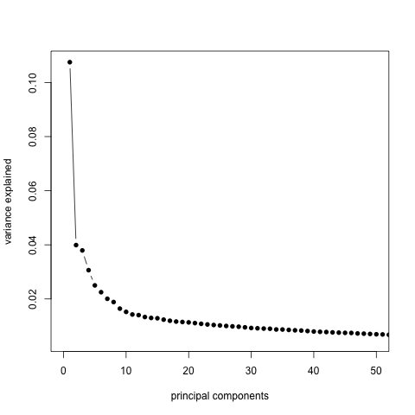
Singular Value Decomposition (SVD) of Tf-Idf Matrix
in R, read Tf-Idf Matrix (sparse), terms and PMID files
singular value decomposition (not centered) for dimensionality reduction and noise filtering
visualization of variance explained by singular values
keep 10 dimensions for further analysis

Slide 8
t-SNE projection of 10-dimensional data
t-distributed stochastic neighborhood embedding
visualization method for higher-dimensional data
tries to optimize relative distances to closest neighbors in n-dimensional space

Slide 9
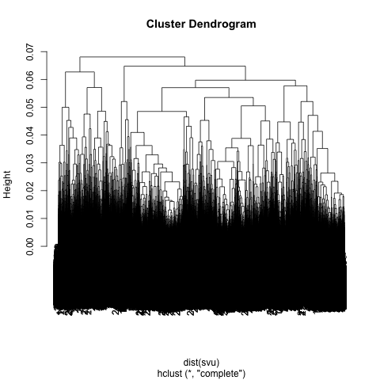
Hierarchical clustering of abstracts
clusters don’t look very good in t-SNE plot

Slide 10
Half-term Summary: Classification of ‘taste’ abstracts
loaded and parsed ~28000 Pubmed abstract with the term ’taste’ into local database
built a TF-IDF matrix
Latent Semantic Analysis (Singular Value Decomposition on TF-IDF)
t-SNE projection
k-means clustering

Slide 11
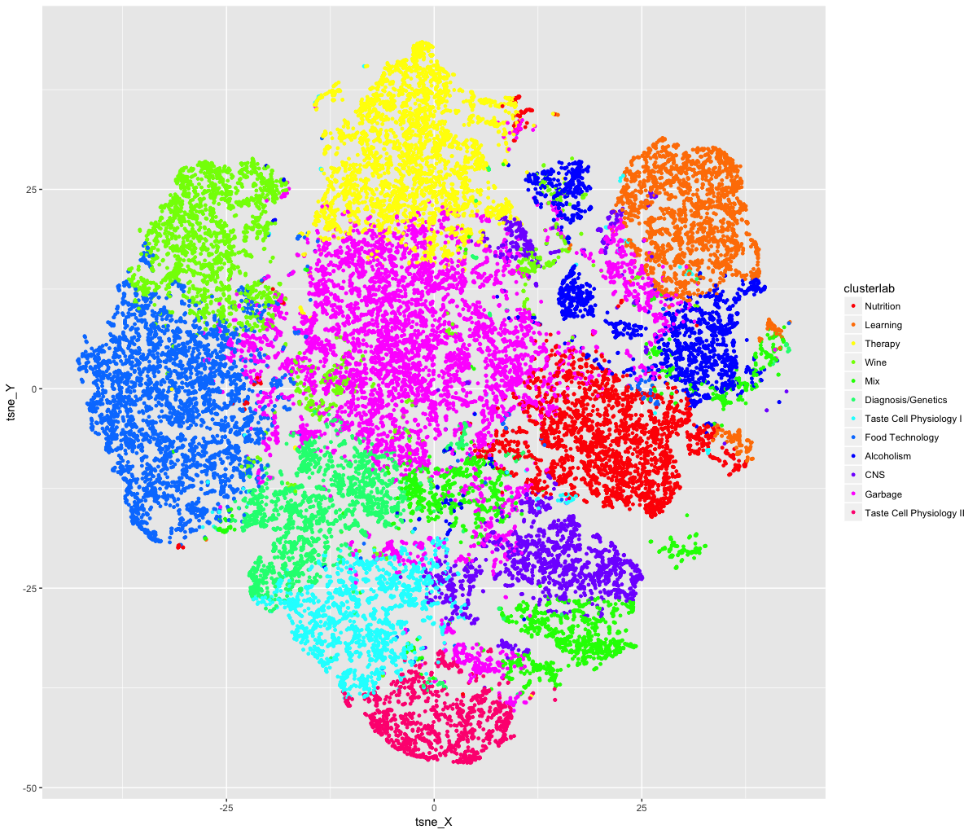
K-means clustering of abstracts (k=12)
clusters look OK in plot, but not perfect
other clustering algorithms failed
clusters in the periphery are associated with topics
the pink cluster in the middle is complete garbage

Slide 12
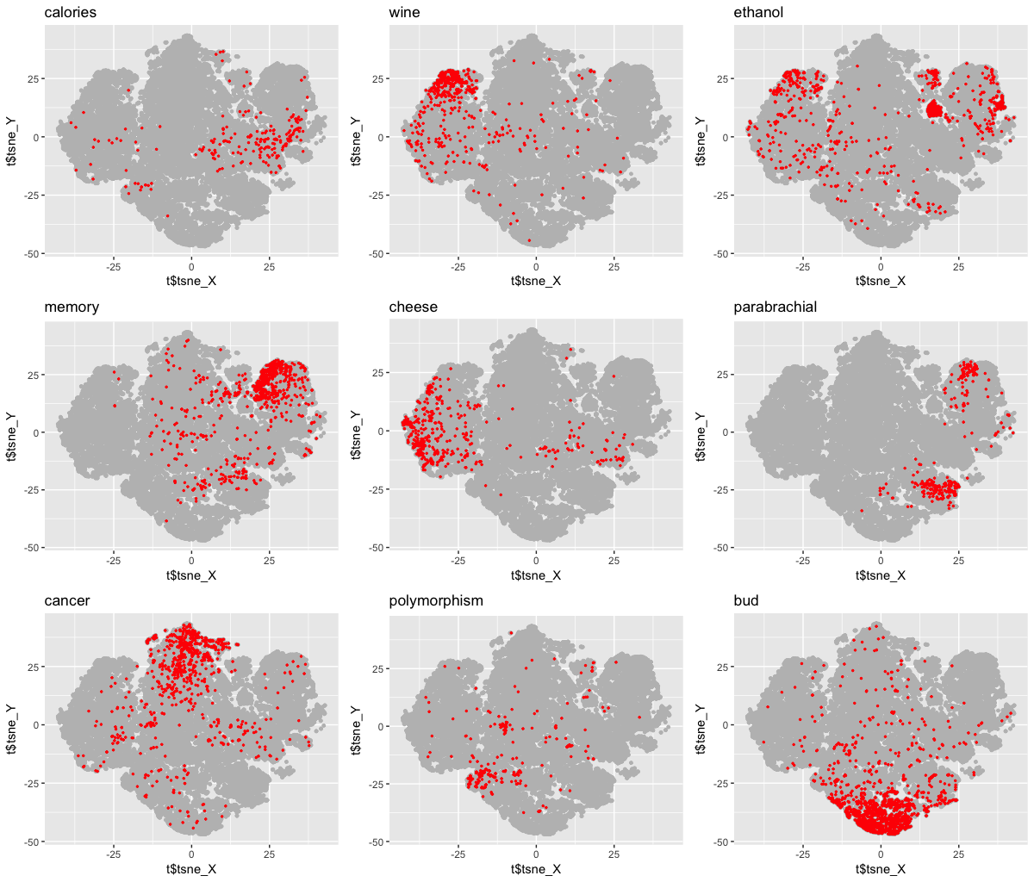
Data exploration with search terms
looked at random titles for each of the clusters
defined search terms that would characterize a cluster

Slide 13
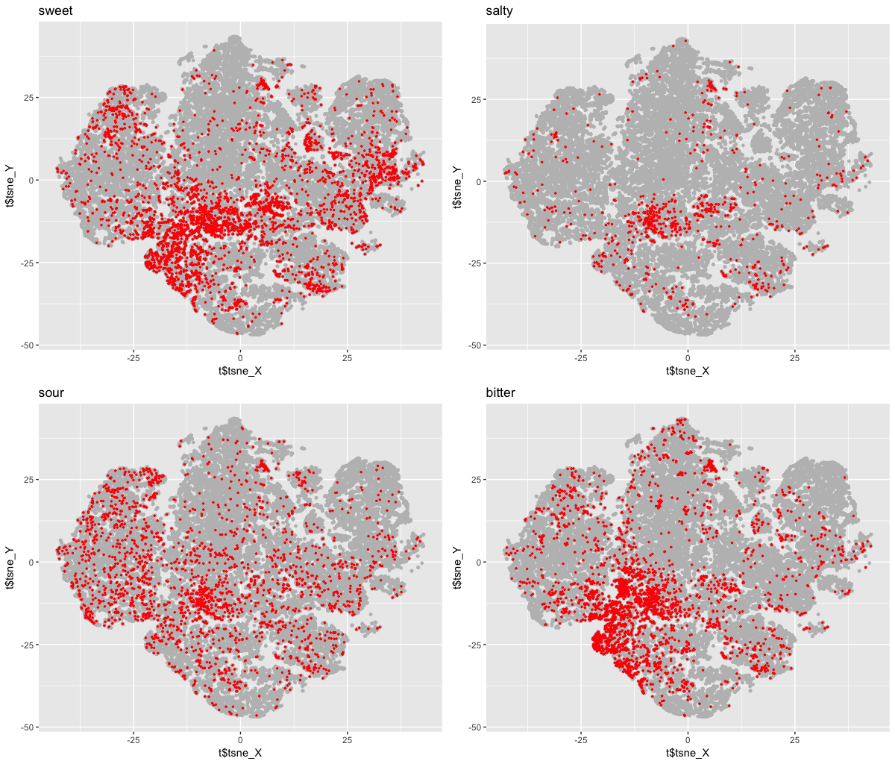
Data exploration with taste modalities as search terms

Slide 14
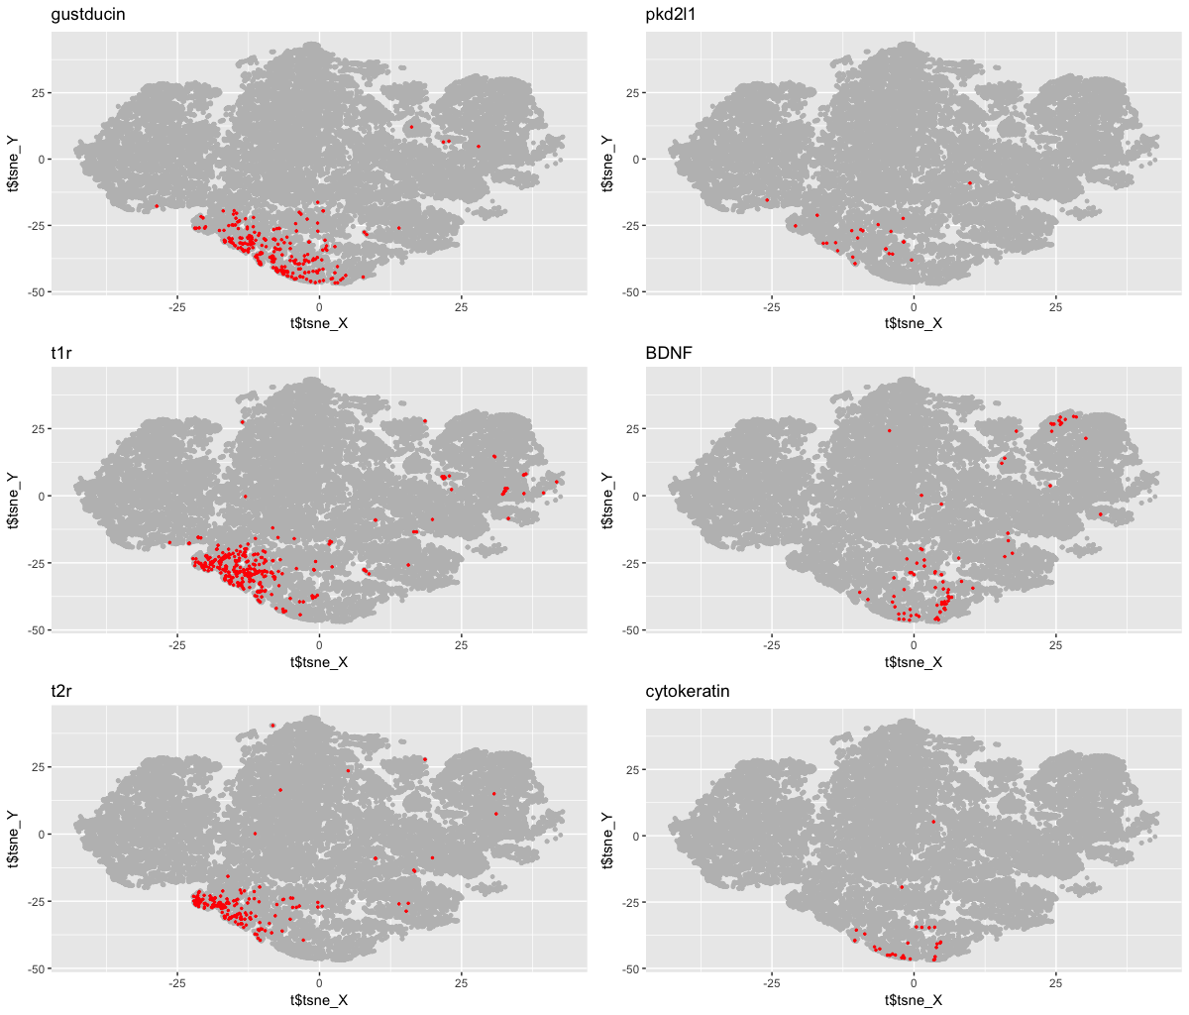
Data exploration with known taste genes as search terms

Slide 15
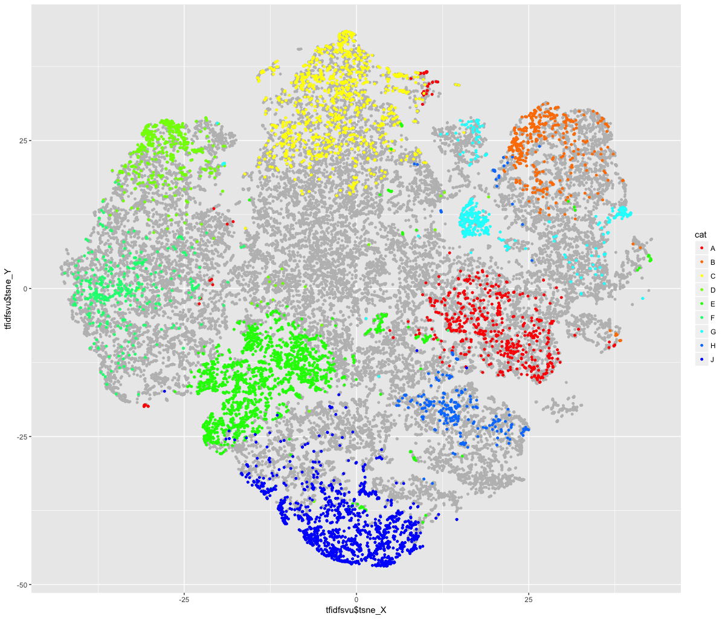
Machine Learning to improve classification
training and test data defined by restrictive combination of k-means cluster identity and search terms
semi-supervised

Slide 16
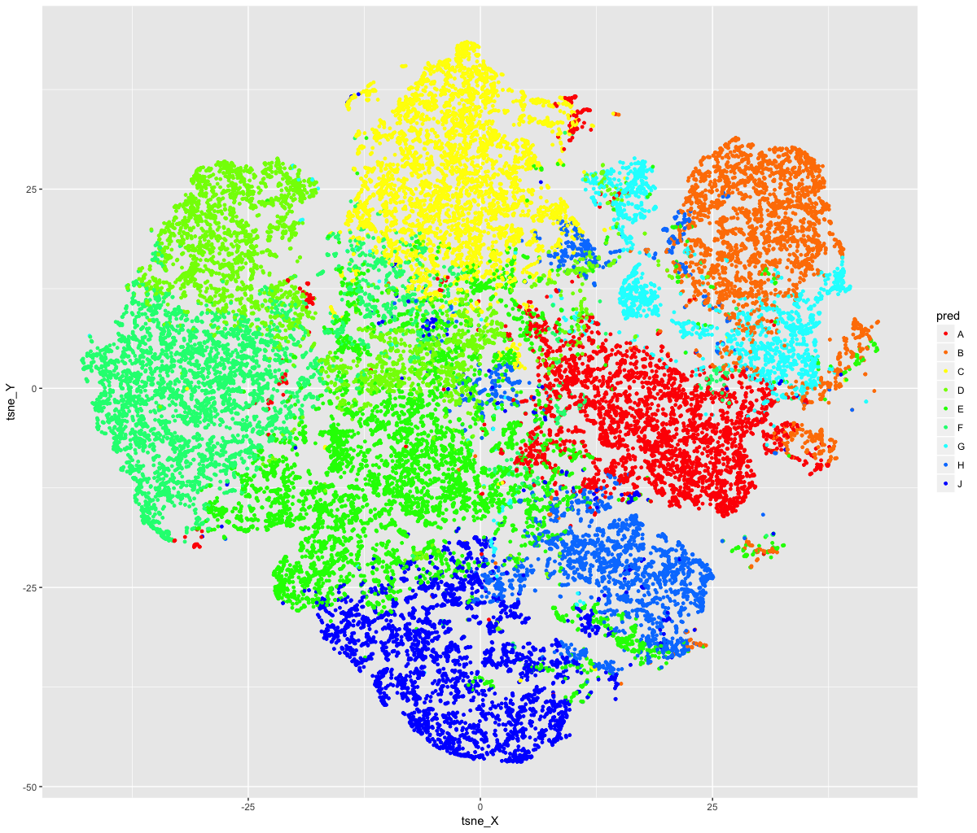
Machine Learning to improve classification
continuous LSA data to predict multiple classes
Random Forest Prediction
accuracy 100% on training set,
>98% on test set
then used to predict all abstracts (force them into one of these categories)

Slide 17
Expression analysis (back in Python)
downloaded a list of all mouse genetic markers from MGI (www.informatics.jax.org) and parsed protein coding genes: symbol, name and synonyms into an SQLite table
filtered abstracts from the ‘taste bud’ category for sentences that have variations of the term ‘express’
then found all gene synonyms in these sentence and consolidated a list of genes with the count of abstracts that they are mentioned in

Slide 18
gene | count
tas1r3 | 39
gnat3 | 34
trpm5 | 27
bdnf | 21
tas1r2 | 20
krt71 | 16
shh | 13
tbpl1 | 13
tas1r1 | 12
cd36 | 12
pkd2l1 | 12
lep | 10
trpv1 | 9
gcg | 8
ffar4 | 8
slc5a1 | 8
334 unique genes detected in taste bud abstracts
top 15 displayed (only 1 artifact)

Slide 19
All the code is at https://github.com/lars-von-buchholtz/BIOF395
The R part of the analysis can be viewed at http://rpubs.com/lvonbuchholtz/BIOF395

